Slide 1
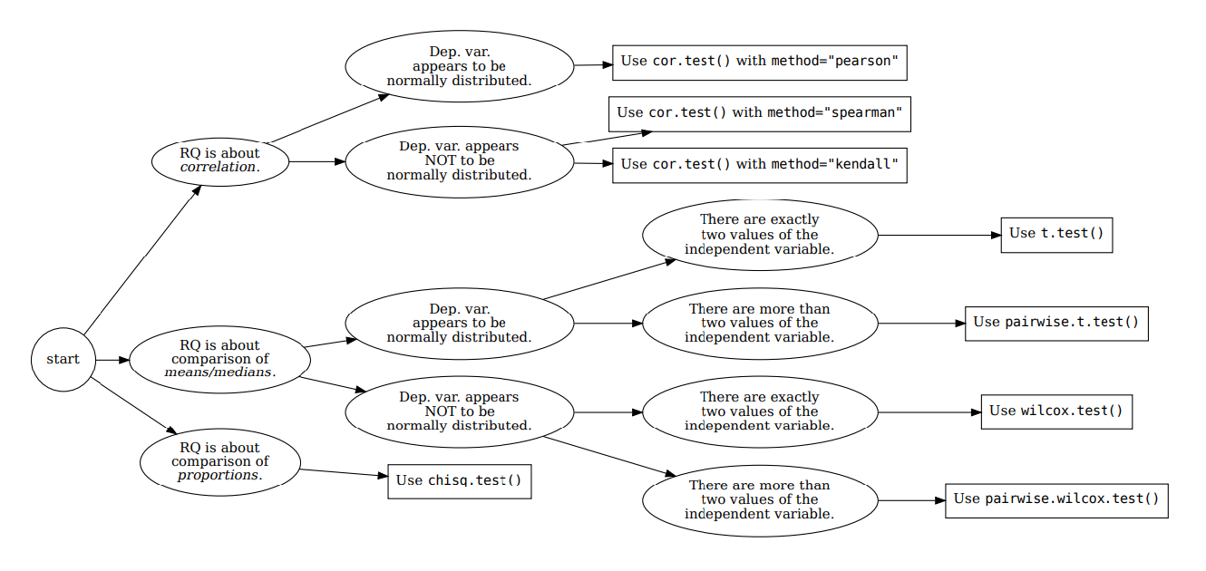







How your RQ + distribution of data (Histogram) leads to a statistical test. Visualization requirements highlighted in yellow.
Histogram & Scatterplots
Histogram and Boxplots
Stacked bar chart (no histogram)
Figure: Decision tree – how Research Questions relate to Visualizations and Statistical Test.

Slide 2

7COM1079-2022 Student Group No:A237 Names of Student Attendees : Uma Eswar Pavan Kumar Jakkampudi
Sai Madhu Vivek Degala
Jason Simon Ganta
Ravindra Sepuri
Venkata Mounika Bollepalli
2
Group Id: A237 Name of Student Presenting:Uma Eswar Pavan Kumar Jakkampudi
Data Analysis – Tutorial Presentation for Feedback Date:

Slide 3
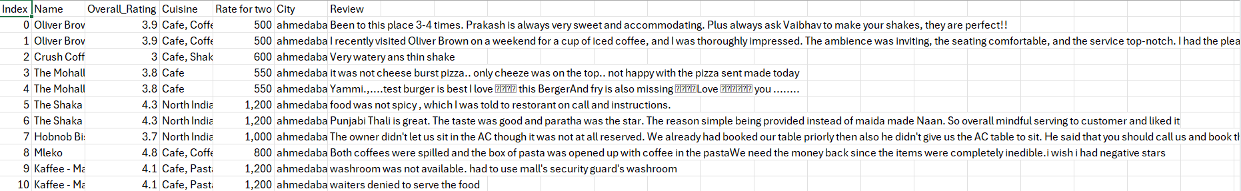
7COM1079-2022 Student Group ID: A237
DS169 (reviews.csv)
Is there a correlation between the cost for two people (Rate for two) and the overall customer rating (Overall Rating) in India?
3
Company | Valuation ($B) | Date Joined | Country
Bytedance | $140 | 4/7/2017 | China
SpaceX | $100.3 | 12/1/2012 | United States
Stripe | $95 | 1/23/2014 | United States
Klarna | $45.6 | 12/12/2011 | Sweden
Epic Games | $42 | 10/26/2018 | United States
Canva | $40 | 1/8/2018 | Australia
Checkout.com | $40 | 5/2/2019 | United Kingdom
Instacart | $39 | 12/30/2014 | United States
Databricks | $38 | 2/5/2019 | United States
Revolut | $33 | 4/26/2018 | United Kingdom
Chime | $25 | 3/5/2019 | United States
Notes:
3

Slide 4
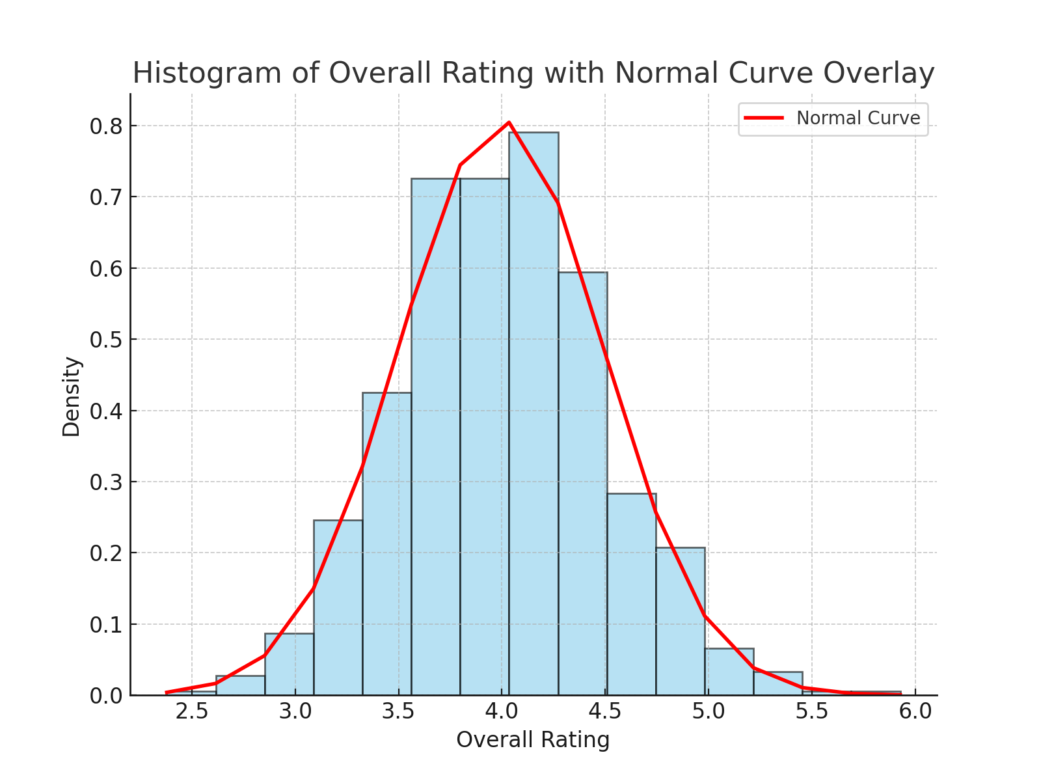
Here is a Histogram showing the frequencies of our dependent variable to include the normal curve overlay.
Our RQ asks about differences in means/ medians
The normal curve overlay follows the contours of the underlying data, so we use the parametric test: t-test.
4

Slide 5
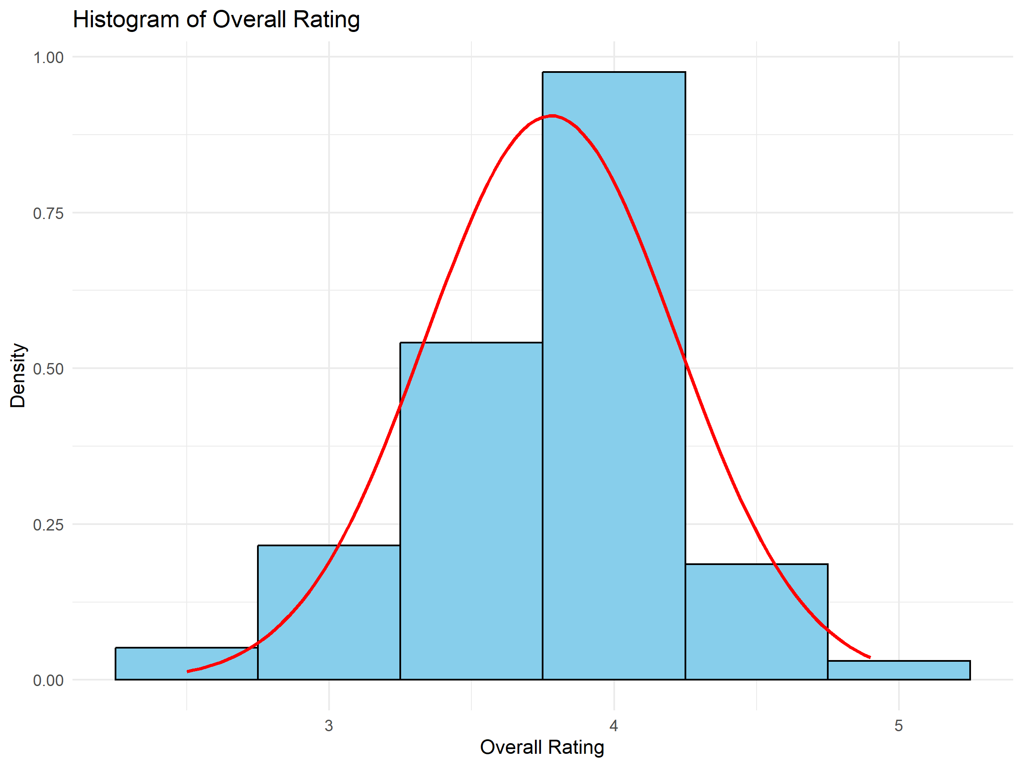
Here is a Histogram showing the frequencies of our dependent variable to include the normal curve overlay.
Our RQ asks about Correlation
The normal curve overlay does not follow the shape of the underlying data, so for our analysis we use the non-parametric test for correlation that does not assume normality: Spearman’s Rho
5
Notes:
5

Slide 6
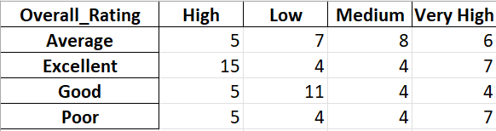
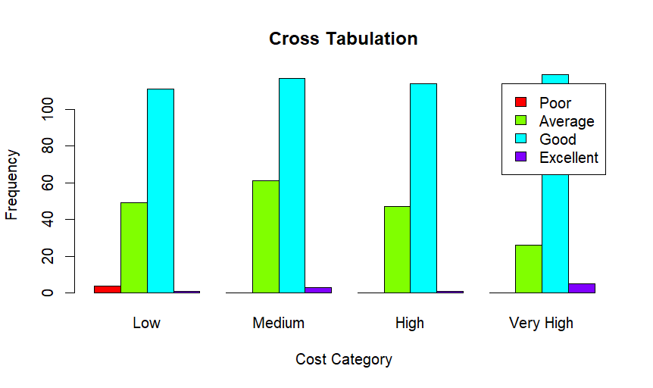
Here is a table (matrix/cross tabulation) showing our dependent variable as rows, and our independent variable as columns. We have at least two values for both variables that are independent of each other (no overlap).
For example:
Our RQ is about differences in proportions
6
Notes:
6

Slide 7
R Script and Results (For ALL types of test) – The Analysis
PRE 7COM1079-2022 Student Group No: ?????
7
Include a snippet of the R code you use to calculate your test statistic.
Give the value of the test statistic.
Tell us the p-value. Is it > or < 0.05?
Is the result significant?
Do you accept or reject the null hypothesis?
What does the result actually mean in the wider context of learning something useful / answering your RQ?
Notes:
7

